Slide 1



Home Purchase Decision Analysis
Florida, New York, North Carolina

Slide 2
Group 2
Team Members:
Syed Shah
Ena Sula
Braily Noesi

Slide 3


CIS4400 Data Warehouse for Analytics Summer 2025

Slide 4
The problem
Most people want a home, but don't even know where to begin
What the homebuyer should focus on
Location
Price and budget

Slide 5
Business Pitch
Help clients find the home they desire

Slide 6

Objective
Help people make an informed decision about home buying

Slide 7
Personas
Homebuyers
Dashboard Developers
IT Project Manager
Data Warehouse Specialist

Slide 8
Requirements
We will find the average price in each county and zip code
In New York, North Carolina, and Florida

Slide 9

What makes a good home purchase?
Data accuracy
Location
Price transparency

Slide 10
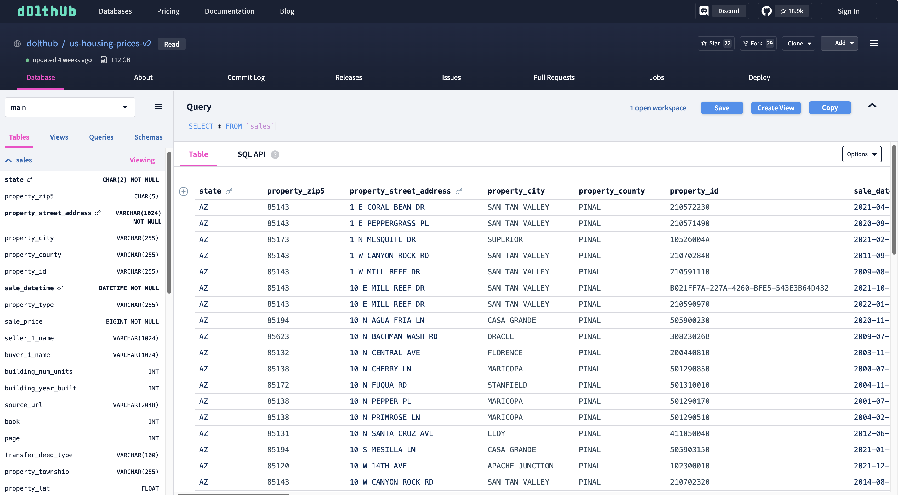
What is the process behind?
Data Sourcing

Slide 11
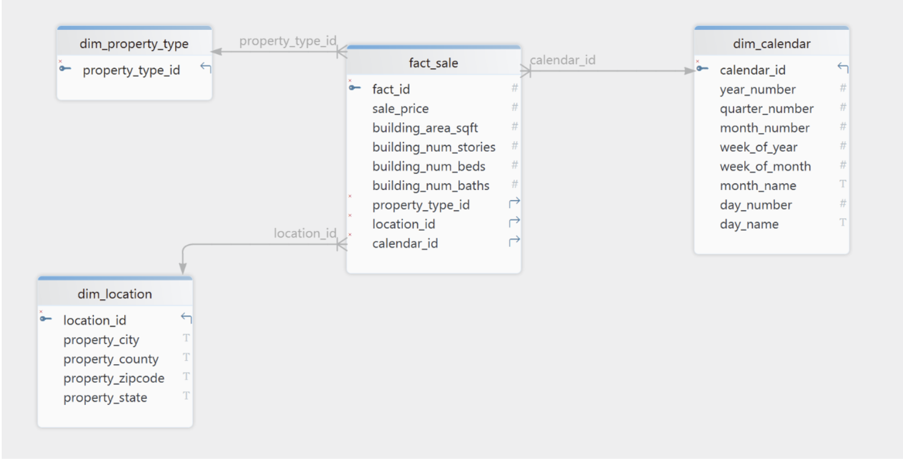
What is the process behind?
Data Modeling
Azure
Snowflake
dbt

Slide 12
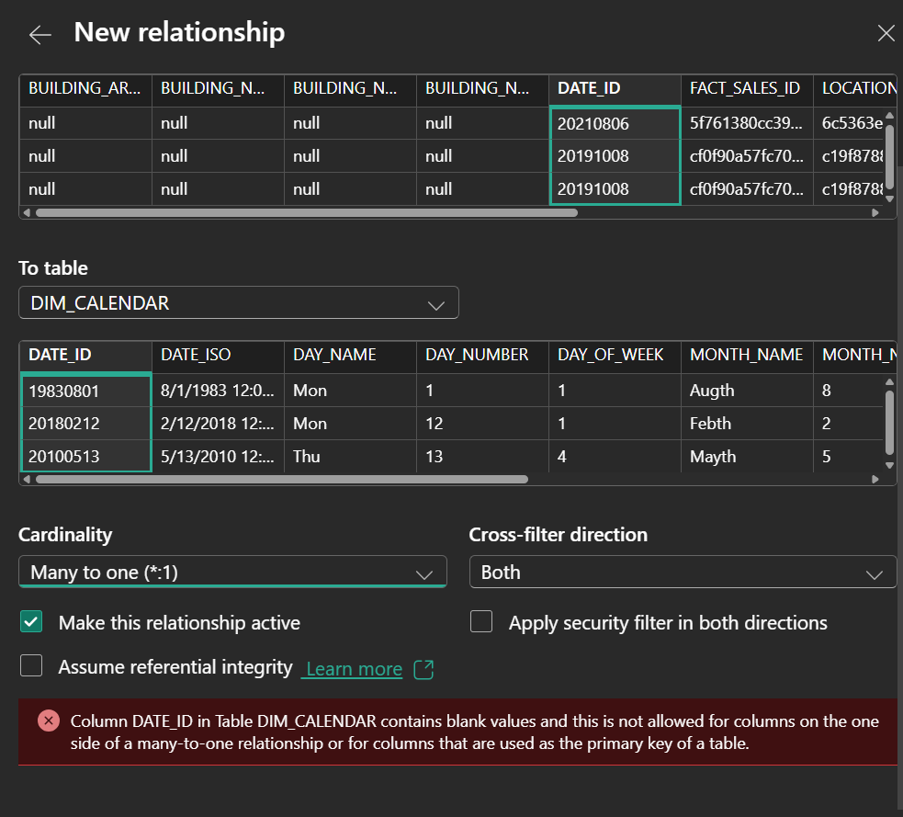
What is the process behind?
Data cleaning

Slide 13
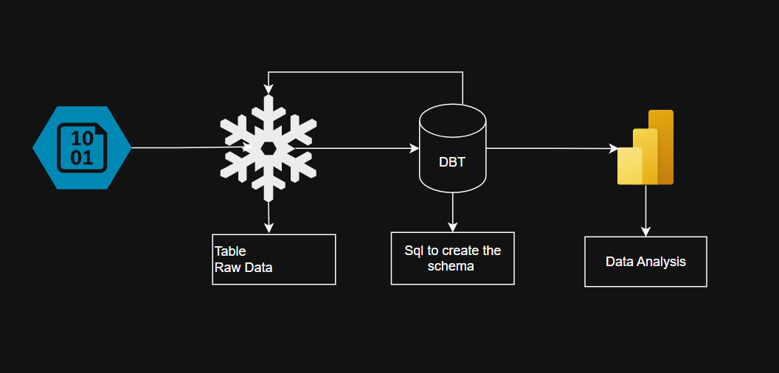
What is the process behind?
Technical
Visualization (Power BI)

Slide 14
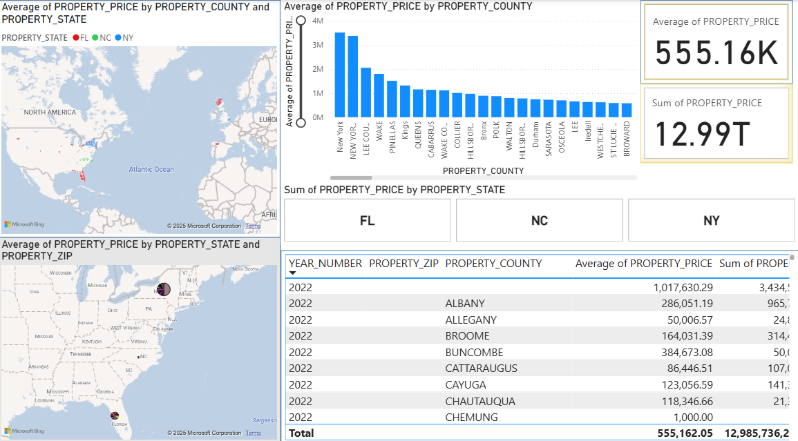
The Visualization

Slide 15
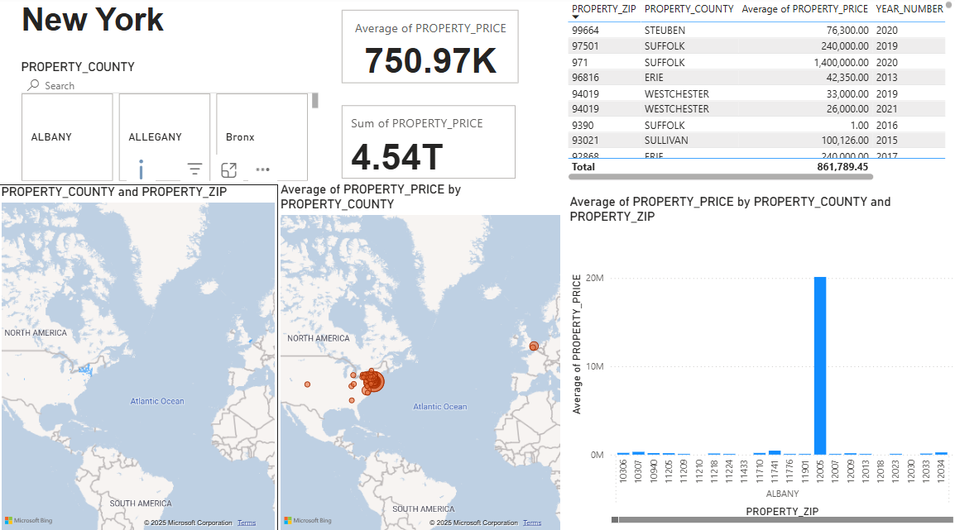

Slide 16
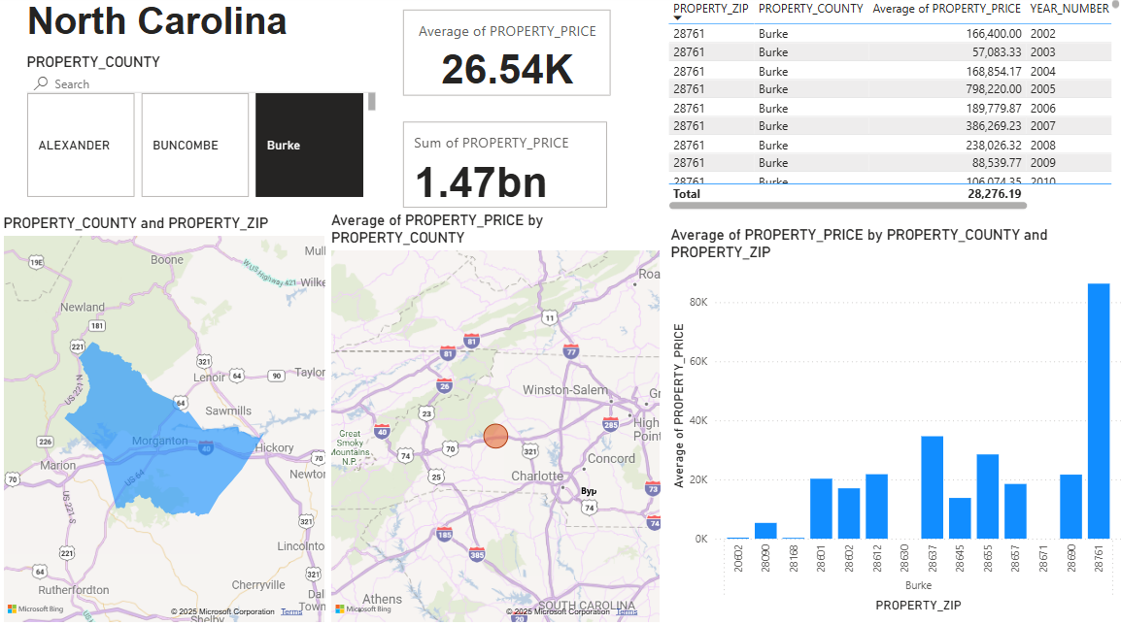

Slide 17
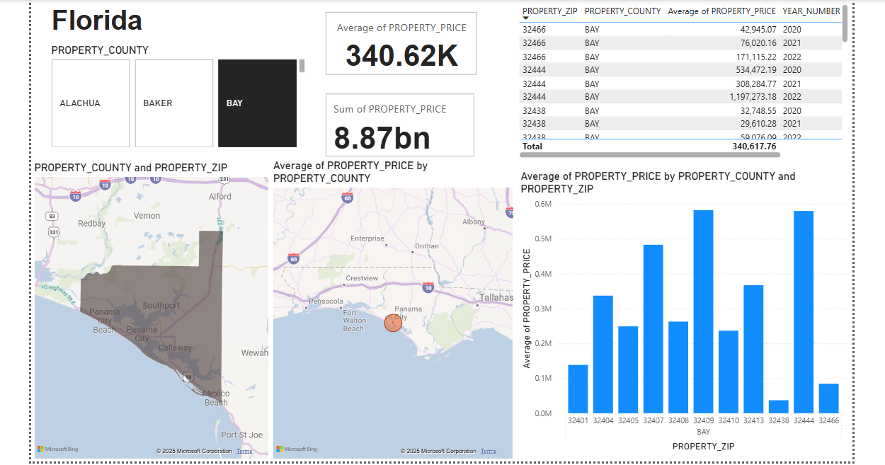

Slide 18
Results
New York
Highest Average: New York $3.52M
Lowest Average: St Lawrence $58.16
North Carolina
Highest Average: Wake $1.80M
Lowest Average: Lee $2.16
Florida
Highest Average: Lee County $2.05M
Lowest Average: Bradford $50.96K

Slide 19
Conclusion
Make an informed, data-driven decision.

Slide 20
Future Work
Other considerations that could be examined while making a decision regarding buying a property are the crime rate, school ranking, public transportation, and groceries suppliers.

Slide 21
Members Contribution
Syed Shah: The leader and has been in charge of keeping us up to date with the analysis.
Ena Sula: In charge of dimensional modeling and visualization.
Braily Noesi: In charge of storing the data in temporary storage, and code process.

Slide 22


Thank You!
{Have any question? }

